Slide 1


Shire of Chittering Client Project 2024
Solution Report
Action Plan
Douglas Fergusson Nathan Bransby Yang Tyin ‘YT’ Lim Sangay Thinley Bianca Ishikawa Daniel Mulenga

Slide 2
Goals/Objectives
Rates payments form
Push notifications
UX/UI consistent with Shire’s existing design
Scalability, Testing & Deployment

Slide 3
Solutions & Technologies
Existing Xamarin and Flutter apps
Ensuring continuity and ease of adoption by the community.
Stripe
Integrated BaaS payment system
Secure, seamless interface for residents.
Commercial support available.
Fallback to BPoint web-view.
Current Features
Fire danger ratings
Problem reports
Real-time notifications
Display of rate balances and payment functionalities
Google Firebase
Integration with Firebase for backend services and push notifications
Utilization of Stripe for secure payment processing
Commercial support available.

Slide 4
Tasks Outline
Authorization and Authentication
User registration and login (admin and resident)
Secure authentication process
User interface for account management features
Likely to be the Google Firebase interface.

Slide 5
Rates Payment Integration
Deploy and test stripe integration
Validation for data accuracy and security
Backend integration (Report Upload)
Feedback for User / Communicate the payment status

Slide 6

Notifications
Fire Rating
Display real time updates.
Push Notification
Notification preferences/channels.
Verify push notification works as expected.

Slide 7


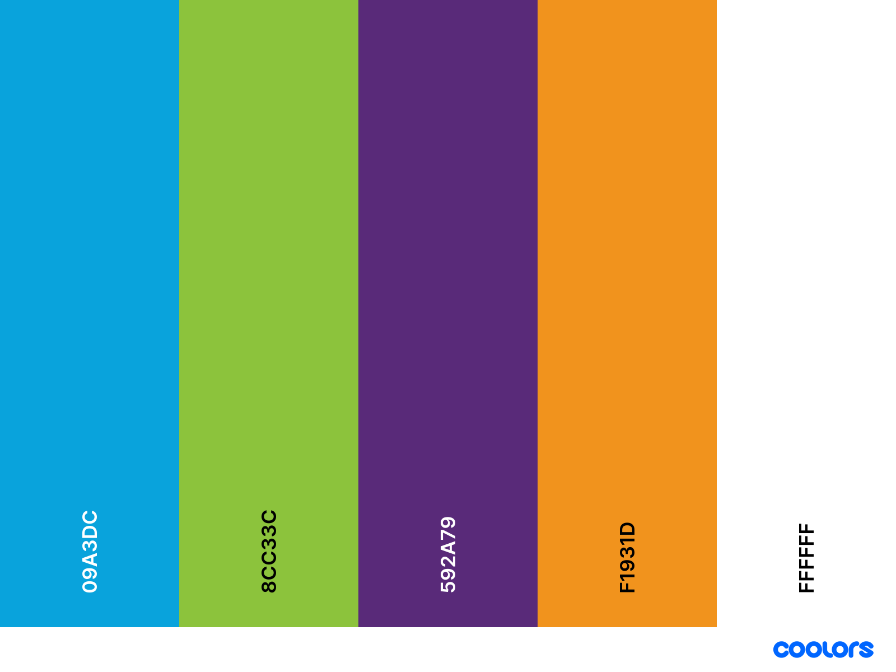
UX/UI
Ensure all features work and function as needed.

Slide 8
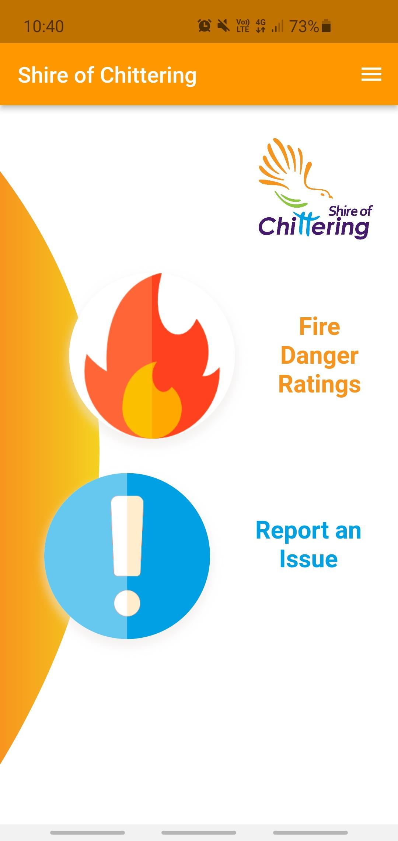
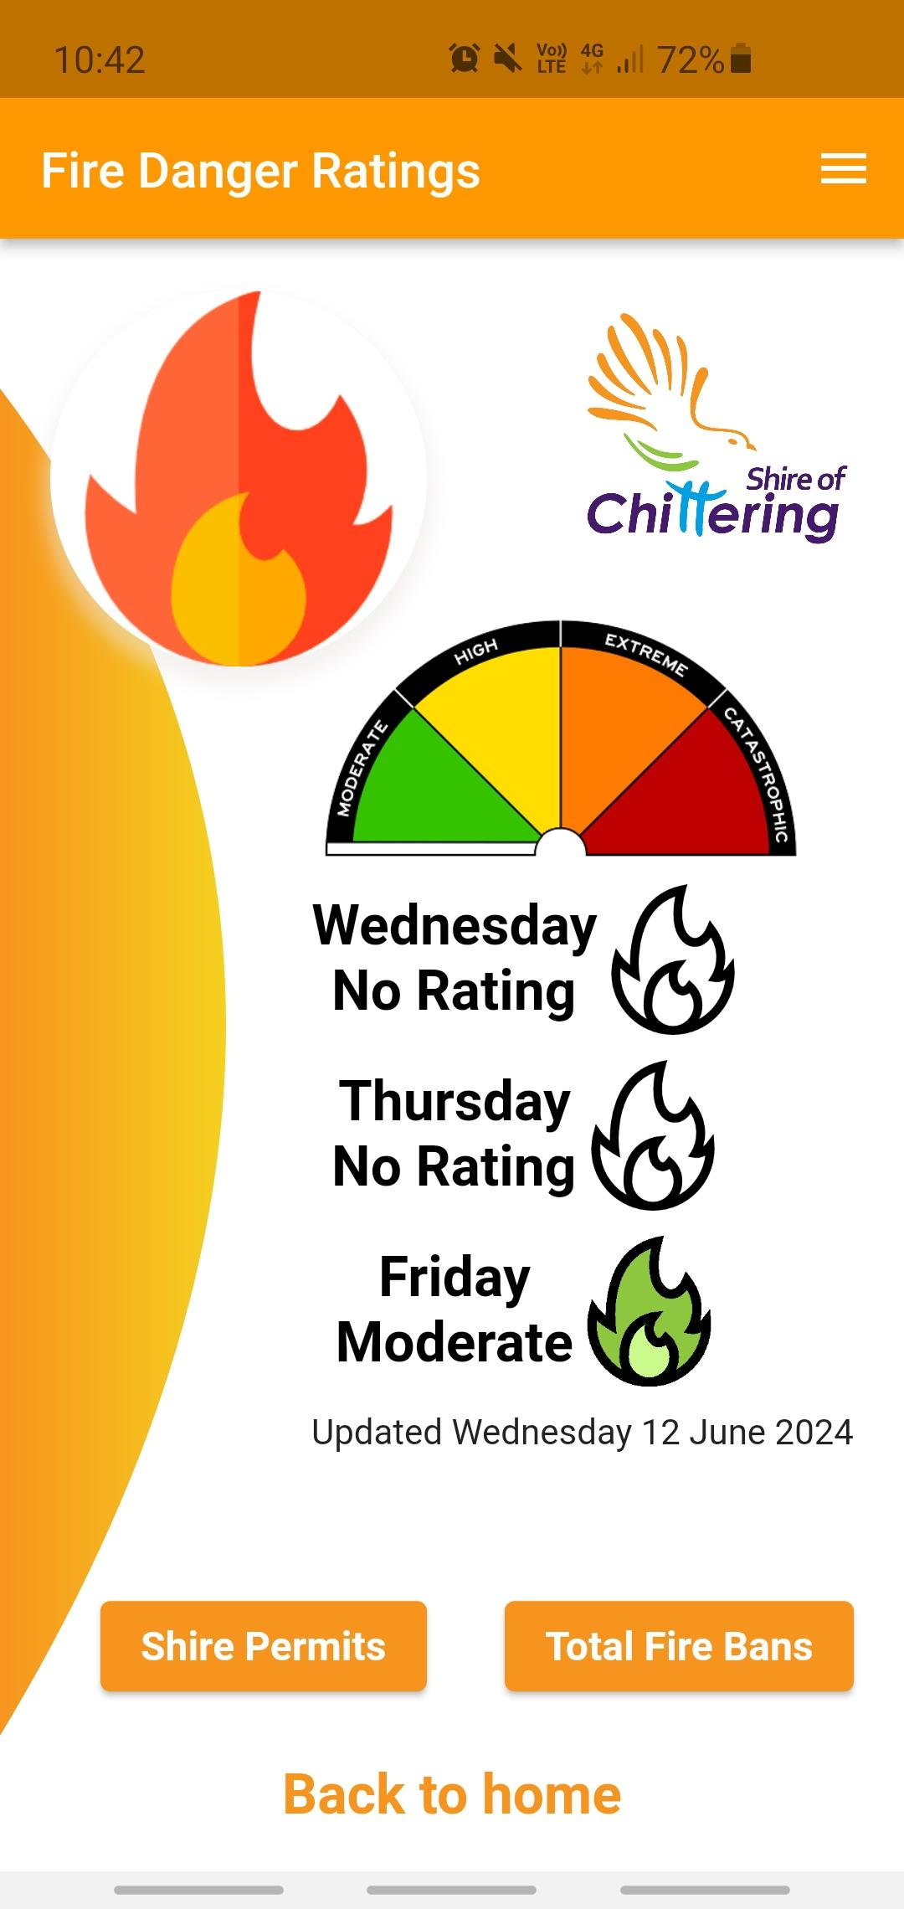
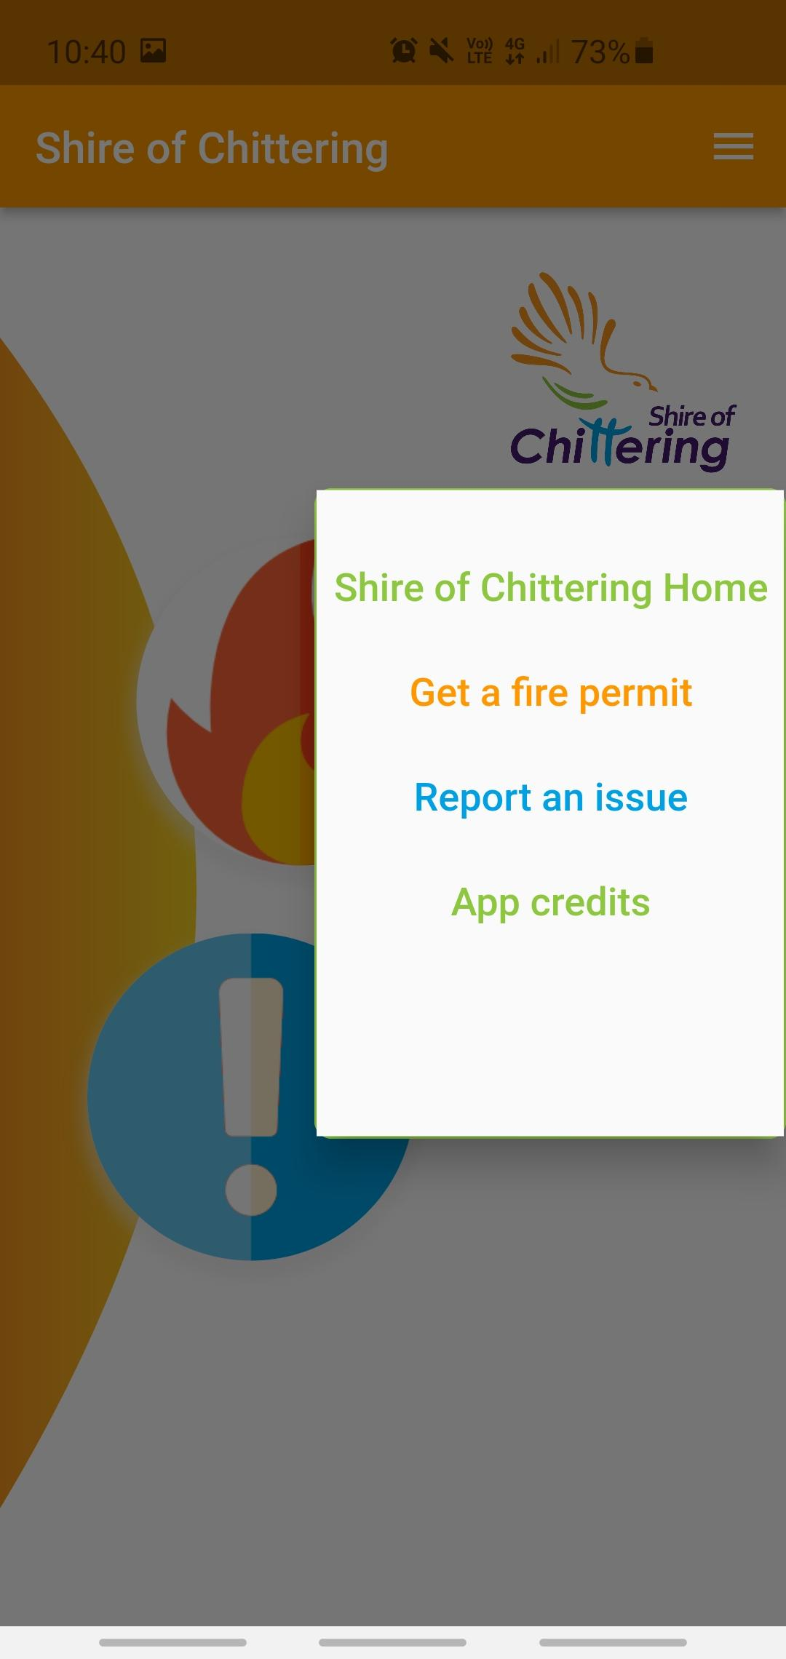

Slide 9
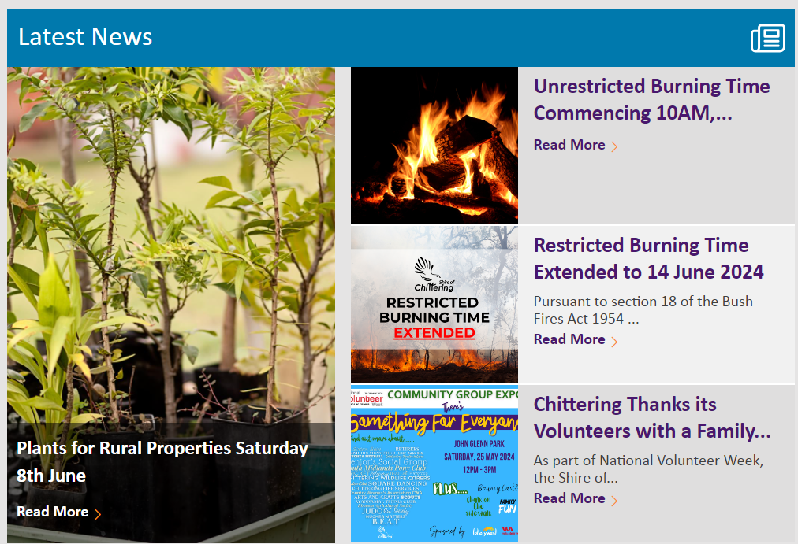
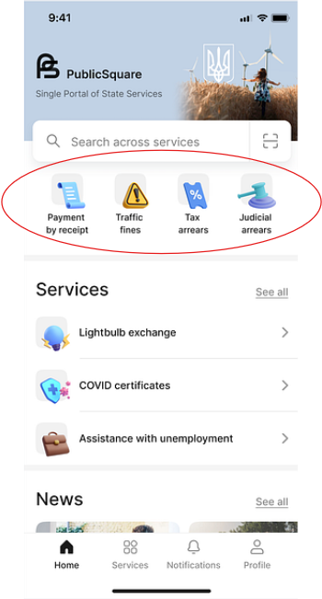
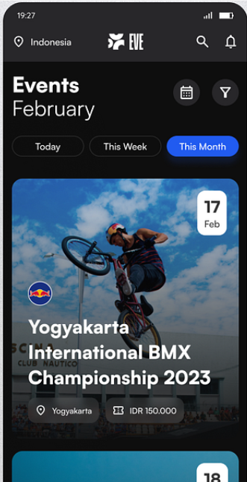
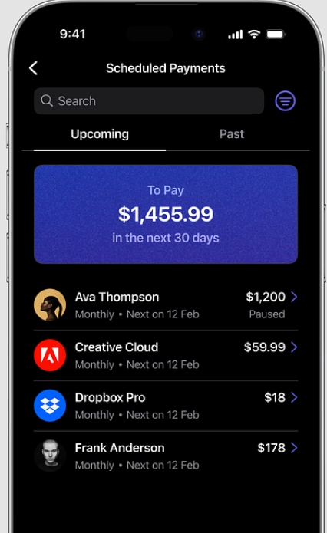

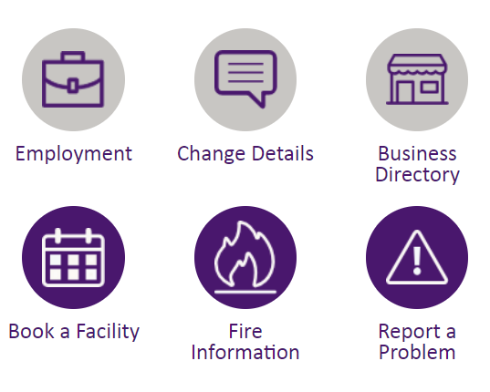
Design Credit: Sergey Masalsky

Slide 10
Testing and Deployment
Testing in area with mobile blackspots.
Deploy the app for production.
Communicate the progress.

Slide 11

Deliverables
Working application
App on mobile app stores
Documentation
Training and Demonstration

Slide 12
Project Timeline
Stages | Things To Do | Estimated Timeline (approximate)
Planning | Detailed Planning and Requirements Gathering | 15th July - 5th August | 3 Weeks (21 days)
Development | Set up Development Environment Real-time Notifications Integrated Payment functionalities User Interface Enhancements | 1st August - 5th October | 9 Weeks (65 days)
Testing and Feedback | Internal Testing Community Feedback Collection | 5th October - 3rd November | 4 Weeks (29 days)
Review | Feedback Review and Adjustments Final Adjustments and Testing | 3rd November - 25th November | 3 Weeks (22 days)
Deployment | Deployment Preparation Go Live Post-Deployment Monitoring | 25th November - 5th December | 1 Weeks (10 days)
Post-Lauch | Ongoing Support and Maintenance Continuous Community Engagementr | 5th December - Year 2025 | Approximately a month

Slide 13
Communication
Email:
Used for formal communication
CC all relevant stakeholders
Frequent Informal Communication:
Microsoft Teams Instant Messaging
For interaction with Shire, TAFE, and students
Meetings:
In-Person or Remote (via Microsoft Teams)
To discuss major milestones
Stakeholder Collaboration:
Microsoft Teams Chat
Includes all relevant stakeholders

Slide 14
Conclusion
Strategic Initiative
Enhances Shire of Chittering’s technological infrastructure.
Addresses challenges in community engagement and administrative efficiency.
Scalable Mobile Applications
Builds on existing Xamarin and Flutter apps.
Introduces real-time notifications and integrated payment systems.
Room for future expansion of app features.
User-Friendly and Reliable
Ensures seamless experience for the community.
Maintains current features (fire danger ratings, problem reports).
Easily maintainable and scalable for future needs.
Achievable Goals
Minimum viable product by the end of 2024.
Continuous improvement based on evolving community needs.

